Slide 1
XCS – 501
Quantitative Aptitude
Nishit Sinha
IIM L (Batch of 2009)
Author with Pearson

Slide 2
Types of Numbers and Their definitions
Real Numbers
Imaginary Numbers
Types of Real Numbers
Rational Number
A rational number is a number that can be expressed as a fraction (p/q) where p and q are integers and q NOT equal to 0
The term ‘rational’ comes from other the word ratio
E.g. - 3/5, 4/8, 22/7

Slide 3
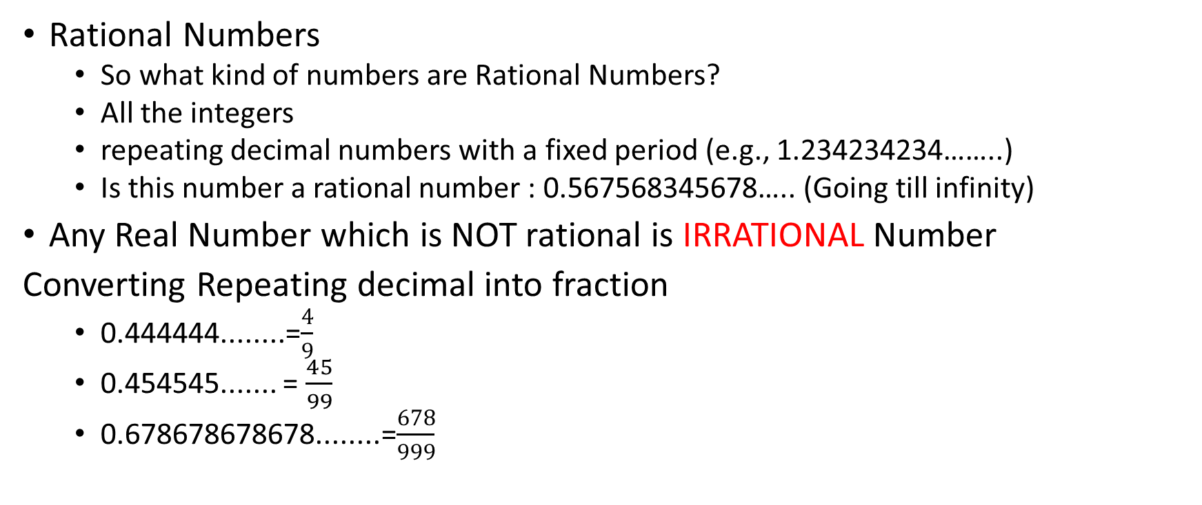
Types of Numbers and Their definitions
Rational Numbers
So what kind of numbers are Rational Numbers?
All the integers
repeating decimal numbers with a fixed period (e.g., 1.234234234……..)
Is this number a rational number : 0.567568345678….. (Going till infinity)
Any Real Number which is NOT rational is IRRATIONAL Number
Converting Repeating decimal into fraction
0.444444........=$\frac{4}{9}$
0.454545....... = $\frac{45}{99}$
0.678678678678........=$\frac{678}{999}$

Slide 4
Types of Numbers and Their definitions
Convert 0.121212...........into rational form
Convert 0.123123123...........into rational form
Convert 3.1232323...........into rational form

Slide 5
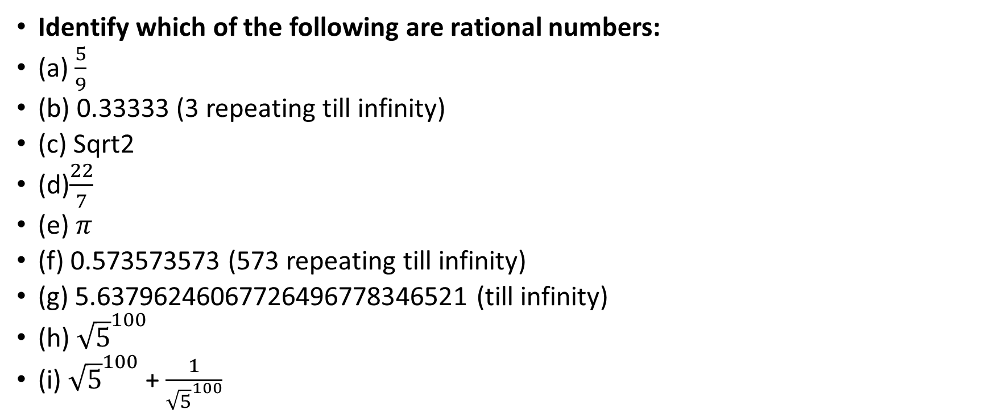
Types of Numbers and Their definitions
Identify which of the following are rational numbers:
(a) $\frac{5}{9}$
(b) 0.33333 (3 repeating till infinity)
(c) Sqrt2
(d)$\frac{22}{7}$
(e) $π$
(f) 0.573573573 (573 repeating till infinity)
(g) 5.63796246067726496778346521 (till infinity)
(h) ${\sqrt{5}}^{100}$
(i) ${\sqrt{5}}^{100}$ + $\frac{1}{{\sqrt{5}}^{100}}$

Slide 6
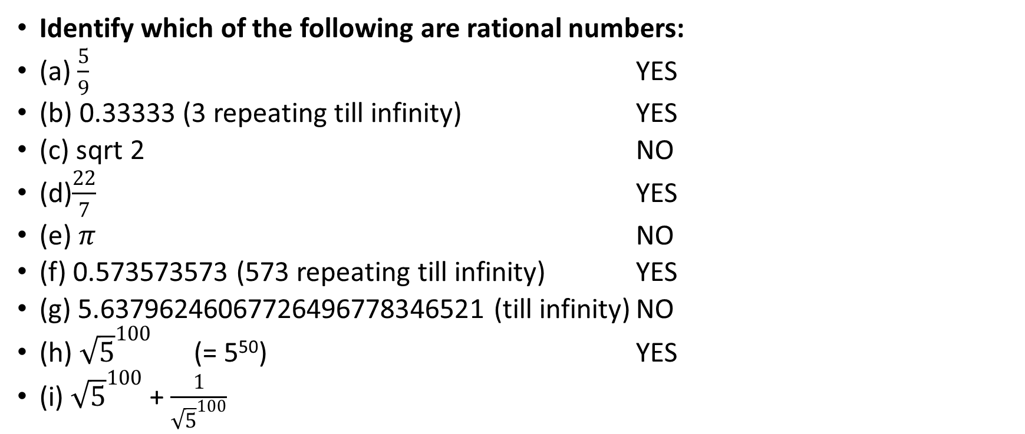
Types of Numbers and Their definitions
Identify which of the following are rational numbers:
(a) $\frac{5}{9}$ YES
(b) 0.33333 (3 repeating till infinity) YES
(c) sqrt 2 NO
(d)$\frac{22}{7}$ YES
(e) $π$ NO
(f) 0.573573573 (573 repeating till infinity) YES
(g) 5.63796246067726496778346521 (till infinity) NO
(h) ${\sqrt{5}}^{100}$ (= 5⁵⁰) YES
(i) ${\sqrt{5}}^{100}$ + $\frac{1}{{\sqrt{5}}^{100}}$

Slide 7
Types of Numbers and Their definitions
Integers
NON-FRACTION REAL NUMBERS
Integers can be either positive or negative or zero. Integers are also classified as Odd or even integers.
Even Integers - Any integer that can be written in the format of 2N is an even integer, where N is an integer. In other words, any number that is divisible by 2 is an even integer. For example: 2, 4, 100 etc.
Odd Integers – Any integer that can be written in the format of 2N +1 is an odd integer, where N is an integer.
Whole Numbers
When 0 is added to the set of natural numbers, we obtain whole numbers. So whole numbers are 0,1,2,3,4,5,................upto infinity. Whole numbers are also known as Non-negative integers. Lowest whole number = 0
Natural Number
Natural numbers are counting numbers: 1, 2, 3, 4, 5................upto infinity. Natural numbers are also known as positive integers. Lowest natural number = 1 = 1st natural number

Slide 8
Types of Numbers and Their definitions
Odd ± Odd = Even (5 ± 3)
Even ± Even = Even (4 ± 2)
Odd ± Even = Odd (5 ± 2)
Even ± Odd = Odd (8 ± 3)
(Odd)^{Even} = Odd (7)² = Odd
(Even)^{Odd} = Even (8)³ = Odd
Odd × Even = Even 7 × 2 = Even
Odd × Odd = Odd 7 × 3 = Odd
Even × Even = Even 6 × 2 = Even

Slide 9
Number Tree
Real number
Rational number
p/q; q ≠ 0
Integers
-2, -1, 0, 1, 2
Fractions
2/3
Irrational number
√2
Whole numbers
0, 1, 2,..
Negative integers
-100, -1
Zero
0
Natural numbers
(positive integers)
1, 2, 3
Postive numbers
Negative numbers
1
Composite number
Prime number

Slide 10
Number Sets
Integers
Whole numbers
Natural Numbers
Rational number

Slide 11
Types of Numbers and Their definitions
QUESTION
Let x, y and z be distinct integers x and y are odd and positive, and z is even and positive. Which one of the following statements cannot be true?
a. y(x-z)² is even b. y²(x-z) is odd
c. y(x-z) is odd d. z(x-y)² is even

Slide 12
Types of Numbers and Their definitions
Let x, y and z be distinct integers x and y are odd and positive, and z is even and positive. Which one of the following statements cannot be true?
a. y(x-z)² is even b. y²(x-z) is odd
c. y(x-z) is odd d. z(x-y)² is even
Answer can be verified by assuming the values x = 1, y = 3, z = 2.
Let us verify options:
a. (x-z) = Odd. So y(x-z)² is also odd. Hence option a is not true.
b. Since y and (x-z) both are odd, hence y²(x-z) is odd. So option b is true.
c. Since y and (x-z) both are odd, hence y(x-z) is odd. So option c is true.
d. Since z and (x-y) both are even, hence z(x-y)² is even . So option d is true.
Hence answer = option a.

Slide 13
Q
Two of the four natural numbers a, b, c and d are odd and other two are even.
Which of the following is definitely an even number?
(a) 3a + b – c
(b) 2a + b – d
(c) a + b – c + d
(d) b + c - d

Slide 14
Types of Numbers and Their definitions
QUESTION:
1st 100 natural numbers are written on a black board. Two persons A and B are playing a game of putting ‘+’ and ‘-‘ sign one by one between any two consecutive integers out of these 100 natural numbers. Both A and B are free to put any sign (+ or -) anywhere provided there is no sign placed already between the two natural numbers. At the end when the signs are put between all such two consecutive natural numbers, result is calculated. If the result is even, then A wins and if the result is odd, then B wins. Who will win?

Slide 15
Types of Numbers and Their definitions
SOLUTION:
It can be seen that there are 50 odd and 50 even numbers.
So, 100 consecutive natural numbers = set of 50 odd and 50 even numbers
Whatever sign we put between two odd numbers, resultant of 50 odd numbers = Even, and similarly Whatever sign we put between two even numbers, resultant of 50 even numbers = Even. Hence net result is Even + Even or Even – Even. In any case, net result = Even.
Hence A will win.
We can also see here that + sign or – sign does not matter here. Irrespective of the signs put by A or B, A is always going to win.

Slide 16
Types of Numbers and Their definitions
Prime Number
Any number that has exactly two distinct factors is known as prime number
2 is the lowest prime number
2 is the only even prime number, and all the other prime numbers are odd.
Composite Number –
A composite number is a positive integer > 1 which is not prime number. In other words, composite numbers have factors other than 1 and itself, and hence composite numbers will have atleast 3 factors or divisors.
Lowest composite number = 4.

Slide 17
Types of Numbers and Their definitions
Properties of Prime Numbers
i. There are infinite prime numbers.
ii. There are infinite set of prime numbers such that difference between them = 2 (represented as N and N+2, where N is a prime number). For example- 3 and 5, or 5 and 7, 11 and 13 etc. Set of these two prime numbers are known as “Twin Primes.”
iii. There is exactly one set of prime number triplet N, N+2, N+4, where N is a prime number (3, 5, 7).
iv. All the natural numbers greater than 1 has atleast one prime factor.
All the prime numbers greater than 3 are of the format 6N ± 1 (but CONTRA is NOT true).

Slide 18
Types of Numbers and Their definitions
QUESTION
A, B, C, D and E are five prime numbers, not necessarily consecutive. Sum of these five prime numbers = 264. It is also given that A < B < C < D < E. What is the value of A⁵?

Slide 19
Types of Numbers and Their definitions
QUESTION
A, B, C, D and E are five prime numbers, not necessarily consecutive. Sum of these five prime numbers = 264. It is also given that A < B < C < D < E. What is the value of A⁵?
SOLUTION
Summation of five prime numbers = 264 = Even number
We know that except 2, all the other prime numbers are odd. Since summation of five prime numbers is even, hence four of these prime numbers are odd and one is even.
Since A is the lowest prime number, hence A = Even prime number = 2
So A⁵ = 2⁵ = 32.

Slide 20
Some General Properties
Some General Properties:
1) If we reverse any two digit natural number, the difference between the original and resulting number will be equal to 9 times the difference between tens place digit and units place digit.
If xy is a two digit number, with x = Tens place digit, and y = Units place digit, then xy – yx = 9 (x-y). For example: 91 – 19 = 9(9-1) = 72
(2) if we add the numbers, let us see what happens then:
xy + yx = 10x + y + 10y + x = 11 (x + y), OR, 11 times sum of the digits at unit and tens place.

Slide 21
Some General Properties
QUESTIONS
When a two digit number is reversed, another two digit number is obtained. Difference between original number and resulting number = 48. How many such two digit natural numbers are possible?
When a two digit number is reversed, another two digit number is obtained. Difference between original number and resulting number = 45. How many such two digit natural numbers are possible?

Slide 22
Some General Properties
QUESTIONS
When a two digit number is reversed, another two digit number is obtained. Difference between original number and resulting number = 45. How many such two digit natural numbers are possible?
SOLUTION
Using Point (1): 9 (x-y) = 45
Or, x – y = 5. Thus, Sets of (x, y) = (5,0), (6,1), (7,2), (8,3), (9,4).
However we cannot take set (5,0) as interchanging this will lead to ‘05’ which is not a two digit number. Hence number of sets possible = 4.

Slide 23
Some General Properties
QUESTIONS
Digits of a two digit number are interchanged. Sum of new number obtained and original number is a perfect square. If tens place digit is larger than units place digit, how many such two digit numbers exist?
SOLUTION
Assume xy is the two digit number. After interchanging digits, new no. = yx.
According to the question, xy + yx = 10x + y + 10y + x = 11 (x + y)
11 (x + y) is perfect square. Since 11 is a prime number, (x+y) should be equal to 11. Now we will see different possibilities so that x + y = 11.
Set of (x, y) = (9, 2), (8,3), (7,4), (6,5) [Since tens place digit is larger than units place digit].
Hence 4 sets are possible.

